Slide 1
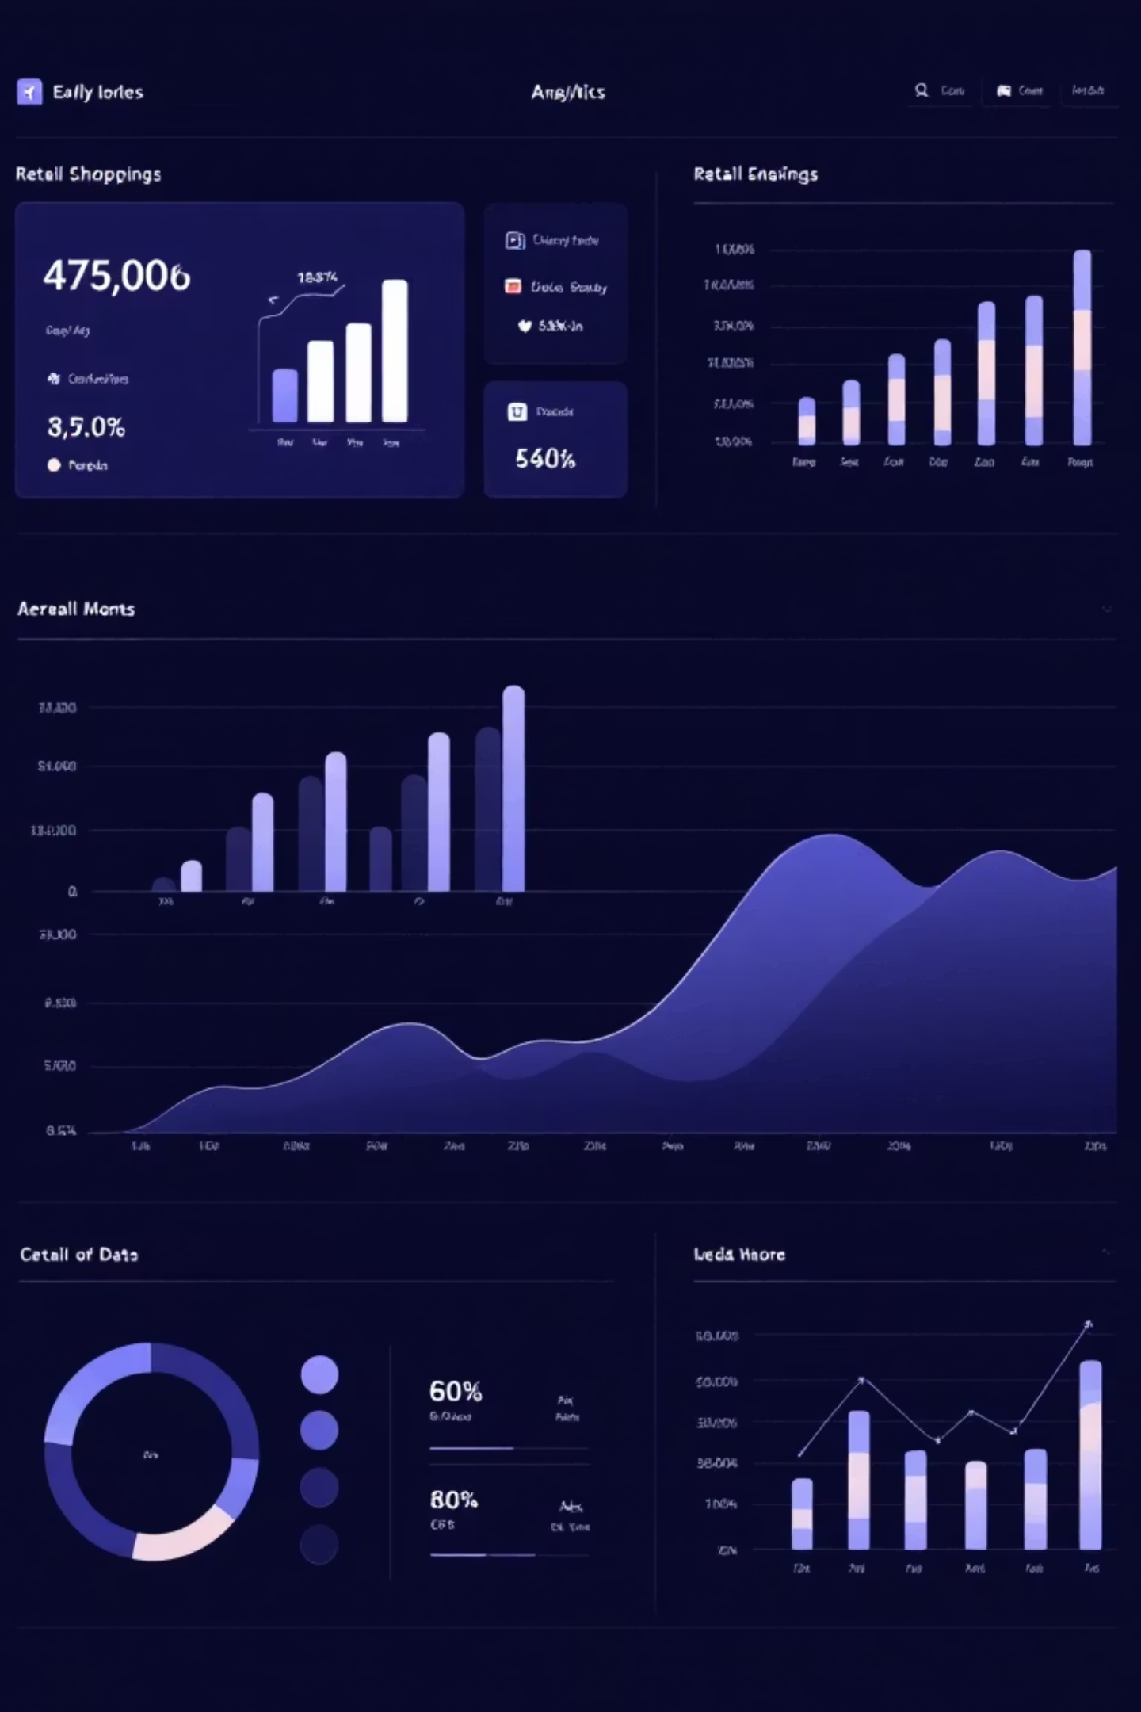
Customer Shopping Behavior Analysis
Uncovering insights from 3,900 purchases to guide strategic business decisions

Slide 2
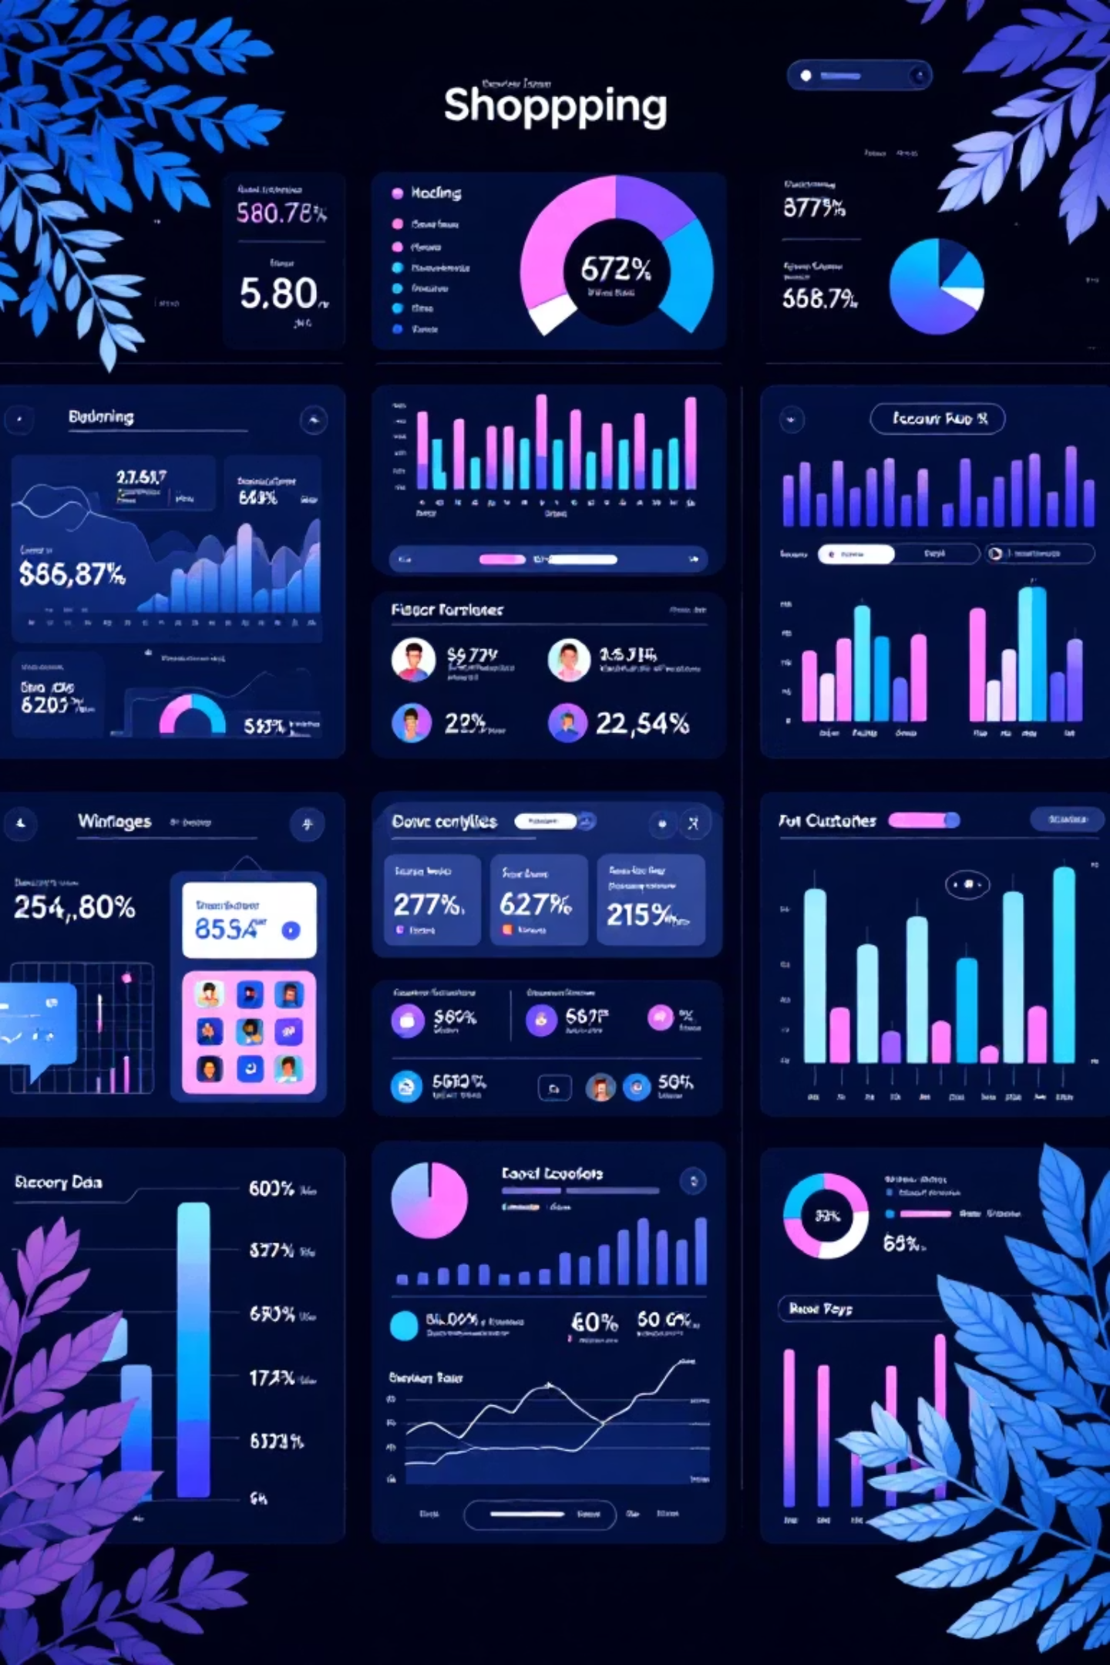
Dataset Overview
3,900
18
$59.76
Total Purchases
Data Points
Avg Purchase
Transactions analyzed
Features per transaction
Per transaction
3.75
Avg Rating
Customer satisfaction
Comprehensive data spanning demographics, purchase details, and shopping behavior across 50 locations

Slide 3
Data Preparation Journey
01
02
03
Data Loading
Missing Data
Feature Engineering
Imported dataset using pandas for initial exploration
Imputed 37 missing review ratings using category medians
Created age groups and purchase frequency metrics
04
05
Standardization
Database Integration
Renamed columns to snake case, removed redundant fields
Loaded cleaned data into PostgreSQL for analysis

Slide 4
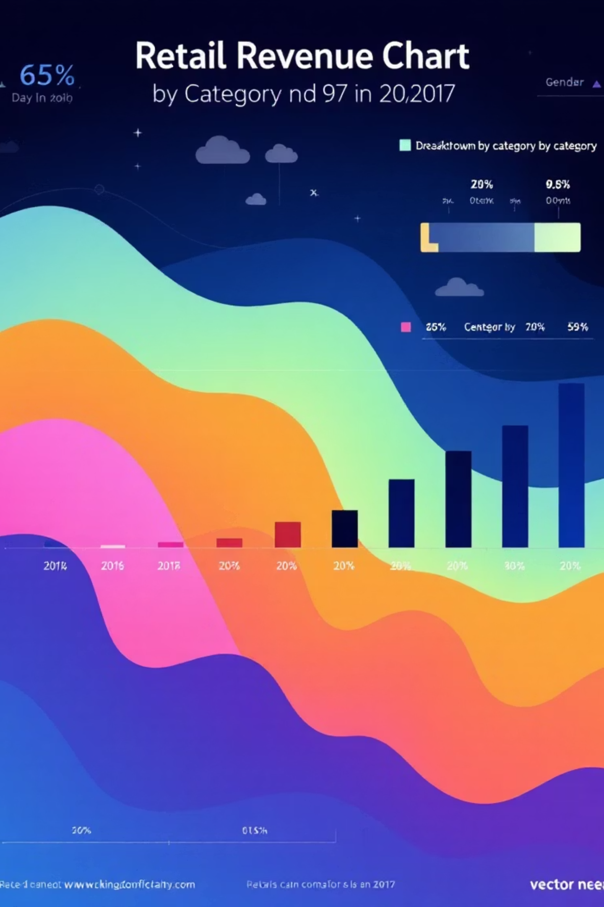
Revenue Insights
Gender Revenue Split
Category Performance
Male: $157,890
Clothing: $104K (45%)
Female: $75,191
Accessories: $74K (32%)
Male customers generate 68% of total revenue
Footwear: $36K (15%)
Outerwear: $19K (8%)

Slide 5




Smart Discount Users
839 Customers
High-Value Buyers
Used discounts but spent above average
Discount-savvy yet premium spenders
Strategic Opportunity
Prime segment for loyalty programs

Slide 6

Product Performance
Top Rated Products
Gloves - 3.86 rating
Sandals - 3.84 rating
Boots - 3.82 rating
Hat - 3.80 rating
Skirt - 3.78 rating
Discount-Dependent Items
Hat: 50% discount rate
Sneakers: 49.66%
Coat: 49.07%

Slide 7



Customer Segmentation
New
1
83 customers
Returning
2
701 customers
Loyal
3
3,116 customers
80% of customers classified as loyal - strong retention foundation

Slide 8


Subscription Analysis
27%
73%
Subscription Rate
Non-Subscribers
1,053 subscribed customers
2,847 customers
Subscribers
Non-Subscribers
Avg spend: $59.49
Avg spend: $59.87
Total revenue: $62,645
Total revenue: $170,436

Slide 9
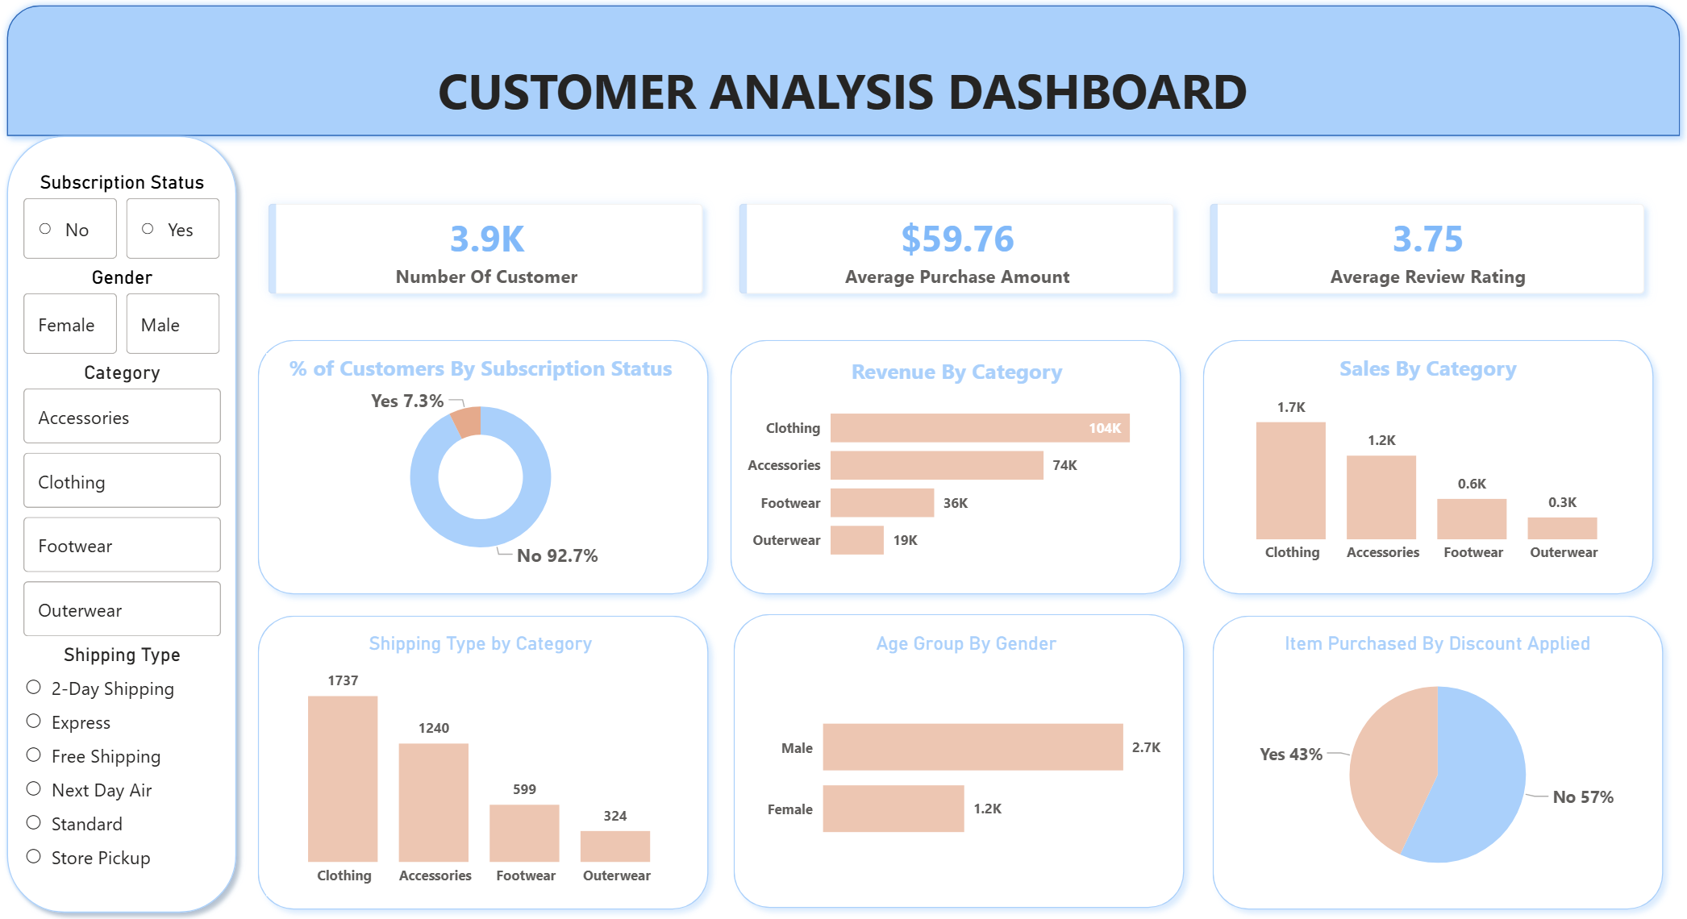
Interactive Dashboard
Real-time visualization of customer behavior, revenue trends, and product performance across all segments

Slide 10
Strategic Recommendations
1
2
3
Boost Subscriptions
Loyalty Programs
Review Discount Policy
Promote exclusive benefits to convert 73% non-subscribers
Reward repeat buyers to strengthen 80% loyal base
Balance 43% discount usage with margin control
4
5
Product Positioning
Targeted Marketing
Highlight top-rated items in marketing campaigns
Focus on high-revenue segments and express shipping users

